Slide 1
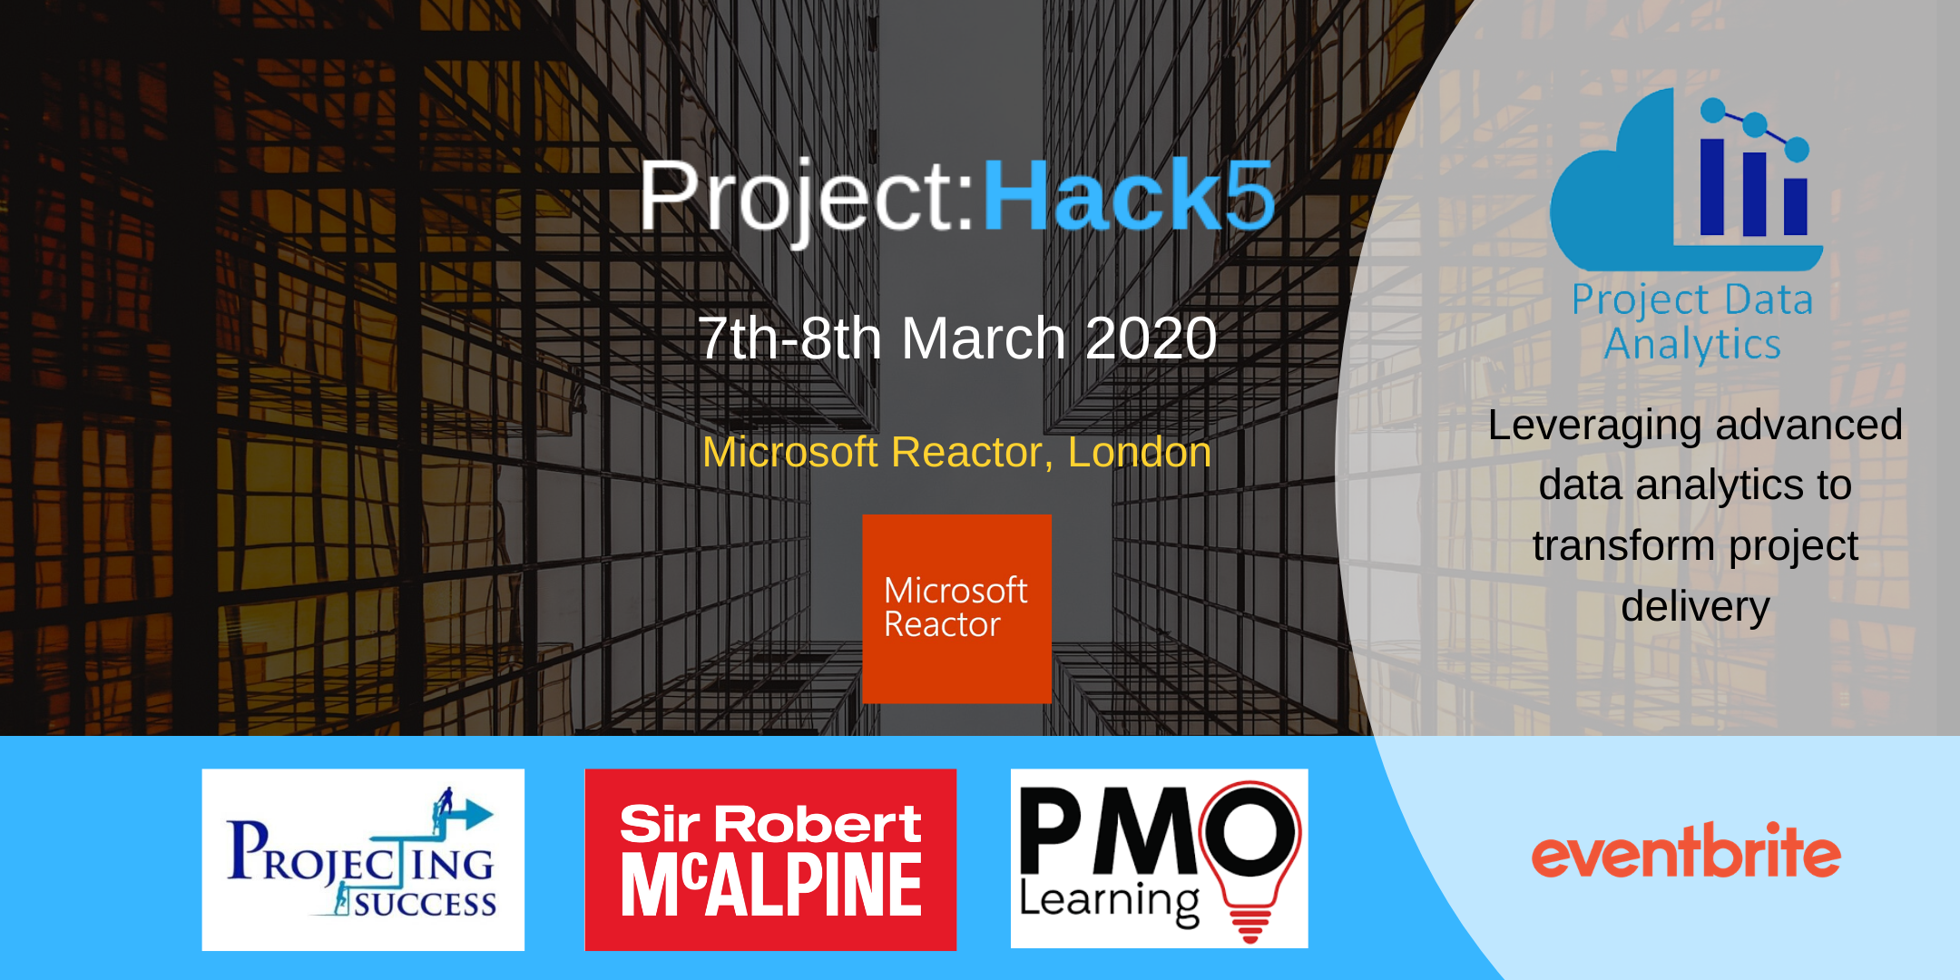

Slide 2
OUR VISION
Data science and analytics will transform how projects are delivered but…
We don’t always understand the art of the possible
We often lack the data
We often lack the skills and expertise
We lack the commercial imperative. Why do we need to do this?
Project:Hack…can help to change this

Slide 3
BEFORE THE HACK
Let us know of any dietary or accessibility requirements
Download software requirements (see slide 6)
Review the challenges provided in this pack
Develop any ideas
Prepare a 1 min elevator pitch (optional) – you will be given the opportunity to pitch any ideas or skills before the Hack begins

Slide 4

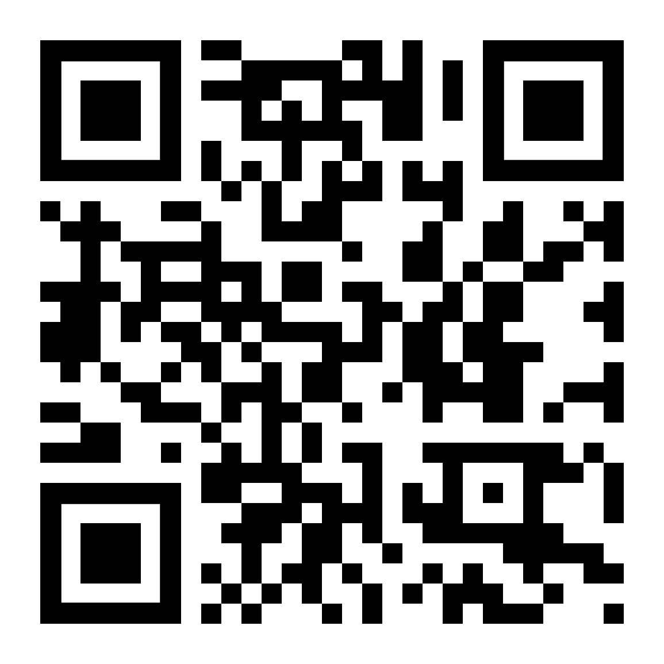
JOIN THE COMMUNITY
We have a Project:Hack5 Slack workspace where you can meet fellow participants and find more details of the challenges, including how to access the data.
Join us here: https://project-hack.slack.com

Slide 5

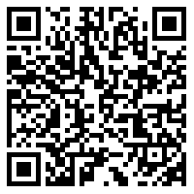
DATA ACCESS
Data for all the challenges and further information relating to them can be found in Google Drive using this link:
https://drive.google.com/drive/folders/10aEn8DioLLCY-ZYXi0niAv4tZQUyQcx6?usp=sharing
You can also find details of how to access data in the #data channel in Slack.
Notes:
Update to google drive share link

Slide 6
SOFTWARE REQUIREMENTS
It is recommended that to get the most out the weekend that you have the following software on your laptops:

Slide 8
Fire Alarm Alert
On activation of the fire alarm, evacuate upon hearing alarm:
Leave the building as quickly and calmly as possible via the nearest fire exit (2 exits via building reception or courtyard side gate).
Do not stop to collect personal belongings.
Proceed immediately to the fire assembly point on Paul street.
Follow any instructions given to you by the Event Support staff, Reception team, Fire Marshals, or members of Security.
Only re-enter the building when told it is safe to do so.

Slide 9
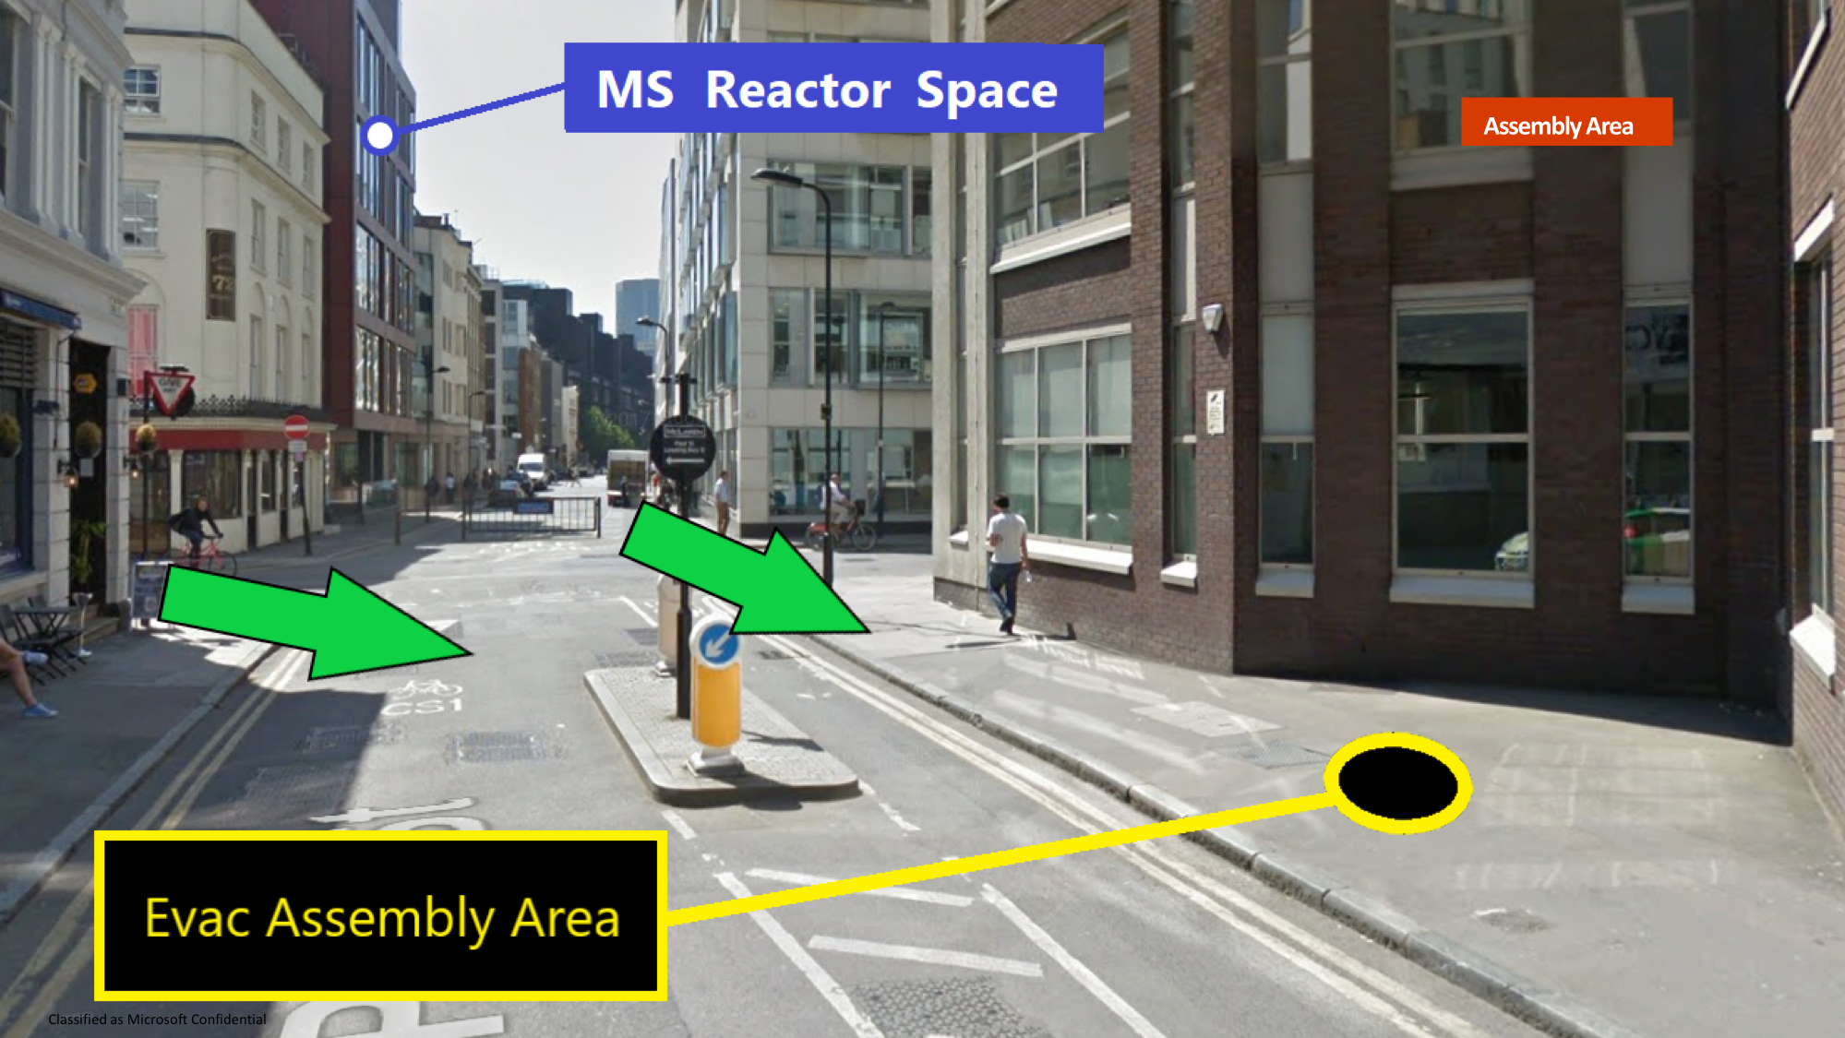
Add here the emergency evac assembly area image

Slide 10

First Aid / Incidents
Please report immediately, all incidents that occur on site to your Microsoft support staff or Security/Reception.
We have on-site First Aid arrangements and facilities. If you require assistance please contact the Event Support staff, Reception or Security.

Slide 11

Smoking
This is a no smoking building. Please smoke outside, away from the building entrances and exits.
Note - This also applies to e-cigarettes / vaporizers.

Slide 12
PHOTOS / VIDEOS
By entering and by your presence here, you consent to be photographed, filmed and/or otherwise recorded.
Your entry constitutes your consent to such photography, filming and/or recording and to any use, in any and all media throughout the universe in perpetuity, of your appearance, voice and name for any purpose whatsoever in connection with the Hack
Please let one of the organisers know if you do not consent.

Slide 13
PRIVACY STATEMENT
As part of registration for and participation in the Hackathon, Project:Hack collects and processes relevant personal data (e.g., name, email address) that will be used to communicate with you before, during and after the Hackathon and that will be used solely in relation to the organisation of the Hackathon, to contact the winners of the Hackathon and to advise you of any future Hackathons.
The organisers will not share your personal data with third parties except within the organising group.
The Hackathon shall retain your data only for as long as necessary with respect to the above described purposes.
If you wish to have your details removed then please contact martinpaver@projectingsuccess.co.uk

Slide 14





HACK RULES
Be nice, work collegiately, help each other. We’ve all given up a weekend to be here.
All teams retain ownership of whatever they have created during the Hackathon. You can choose to make your code available as open source to provide a way for other people sharing your vision to contribute to your project, however choosing to do so is entirely up to you.
Hackathons are like marathons. Some people go to compete but most people take part to better themselves and have fun. Whatever the reason is you're at a hackathon, make sure you're upholding the hacker spirit by collaborating with other teams, helping beginners, and having fun.
No discrimination, harassment, bullying or anything else that may impact your co-hackers.
Have fun!

Slide 15
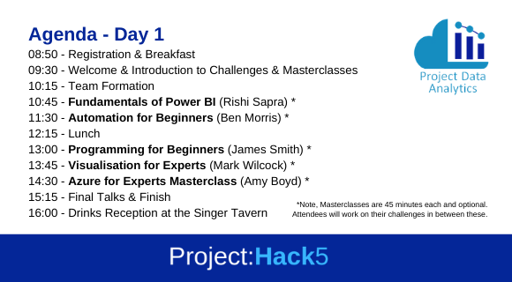

Slide 16
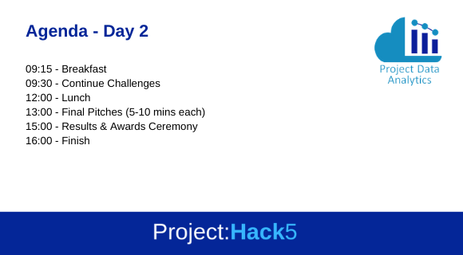
AGENDA – DAY 2

Slide 17
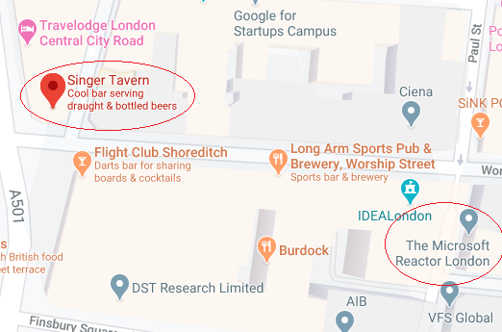
Please join us for a drink!
The Singer Tavern
1 City Road, London, EC1Y 1AG
singertavern.com
2 mins walk away
Saturday 7th March
@ 16:00-19:30
Notes:
CP to add map and directions link

Slide 18
TEAMS
Max 6 in a team
Multiple teams can tackle the same challenge
Try and build a team with a range of skills – this will help you succeed!
Data Science – Machine Learning & AI
Developer - Apps
Data Analyst - Python/R
Data Visualisations
Project Management

Slide 19




CHALLENGES
Challenge# | Challenge Title | Difficulty Level
Challenge 1 | Optimising Crane Usage. | Intermediate
Challenge 2A | 'Code Your Own' PPE Object Recognition Model | Advanced
Challenge 2B | PPE Object Detection Application with Power Apps | Intermediate
Challenge 3 | Specification Issue Detection | Advanced
Challenge 4 | Natural Language Processing on Lessons Learned Data | Intermediate
Challenge 5 | Voice Recognition Safety Observation App | Advanced
Challenge 6 | Incident Dashboards for the Industry | Intermediate
Challenge 7 | Monte Carlo Risk Analysis | Advanced
Challenge 8 | Sentiment Analysis of Observation Data | Intermediate
Challenge 9 | Early Warning Safety System | Advanced
Notes:
BM to update

Slide 20
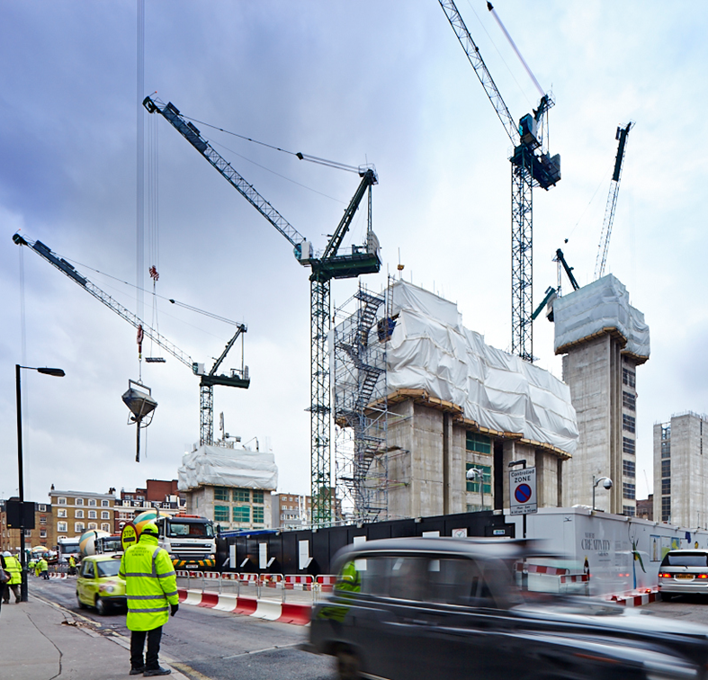
CHALLENGE #1 Optimising Crane Usage

Slide 21
CHALLENGE #1
Problem Statement - Can we optimise crane usage by reducing the amount of time cranes are out of action due to weather-related issues?
Output - Insight into the crane data (when are cranes usually winded off), Insight into relationship between crane wind measurements and the wind data, How can we use this data to make better predictions of future crane usage?
Benefits - Reduced costs – less time expensive equipment and skilled operatives are sat around not able to work, Reduced project delays – better future planning will reduce the impact poor weather will have on project schedules

Slide 22
CHALLENGE #2A 'Code Your Own' PPE Object Recognition Model

Slide 23
Problem Statement - We have a camera above turnstiles on site that record each worker as they enter the site. Can we build our own object recognition model in Tensorflow, PyTorch or similar, to this video to detect whether or not a worker is wearing the correct PPE equipment? Output - An object recognition model, built in Python or similar, to detect if workers are wearing correct PPE equipment, An output for each test video of the workers entering site with the model placing boxes around each item of PPE equipment and labelling it. Benefit - Improved health and safety – workers are more likely to be wearing correct equipment as they enter site if they know they are being checked automatically, Improved compliance – it is a legal requirement for worker to wear the correct equipment
CHALLENGE #2A

Slide 24
CHALLENGE #2B PPE Object Detection Application with Power Apps

Slide 25
Problem Statement - We have a camera above turnstiles on site that record each worker as they enter the site. Can we develop an application in Power Apps that uses the built in AI Builder to train an object recognition model? Output - An app in Power Apps that uses the built in AI builder. This app should be able to recognise PPE objects in an image, and send an alert if the correct equipment is not being used. Benefit - Improved health and safety – workers are more likely to be wearing correct equipment as they enter site if they know they are being checked automatically, Improved compliance – it is a legal requirement for worker to wear the correct equipment
CHALLENGE #2B

Slide 26
CHALLENGE #3 Specification Issue Detection

Slide 27
CHALLENGE #3
Problem Statement - Can we develop an algorithm to parse the text in specification documents to identify and highlight any errors that exist?
Output - A tool to parse these specification documents and highlight any errors with missing, incorrect or out of date standards
Benefits - Improved quality – specification documents would be of a higher quality as they would contain less errors

Slide 28
CHALLENGE #4 Natural Language Processing on Lessons Learned Data

Slide 29
CHALLENGE #4
Problem Statement - What insights can we extract from unstructured lesson learned data?
Output - Comparison between insights gained into the construction lessons learned and insights into the NASA and EA lessons, Topic modelling to pick out common themes in the data
Benefits - Improved learning from one project to the next

Slide 30
CHALLENGE #5 Voice Recognition Safety Observation App

Slide 31
CHALLENGE #5
Problem Statement - Sometimes it may not be suitable to type up observations when on site, for example if a user is wearing gloves or it is raining. Can we log safety observations using voice recognition technology that takes the user through a decision flow to correctly log the safety observation?
Output - Improvements to the current voice observation app in dialogflow that increase its capabilities and the tasks in can be used for.
Benefits - There are certain legal requirements that exist around health & safety, and this application will ensure some of those requirements are met, This can be used to provide statistics and insights on safety observations, The application will improve the quality of health & safety observations that are recorded.

Slide 32

CHALLENGE #6 Incident Dashboards for the Industry

Slide 33
CHALLENGE #6
Problem Statement - Using incident logs and RIDDOR data can we develop an industry standard dashboard for incidents and health and safety KPI data?
Output - Detailed analysis of the data detailing any insights gained into the reason for certain accidents occurring. An interactive dashboard that will allow us to drill down into the data and interrogate it in detail
Benefit - More efficient deployment of available health and safety resources, Better design and targeting of accident prevention measures, Prevention of injuries, death and ill-health in workplaces

Slide 34
CHALLENGE #7 Monte Carlo Risk Analysis

Slide 35
CHALLENGE #7
Problem Statement - How much risk money does the project need to holid in order to meet our risk exposure?
Output - Using Monte Carlo Analysis, produce an output with a range of percentage confidence. Management can then decide a percentage confidence for the results.
Benefit - Improved risk management

Slide 36
CHALLENGE #8 Sentiment Analysis of Observations

Slide 37
CHALLENGE #8
Problem Statement - Users enter comments into our Observation app, but generic tools struggle with construction terms, British English, and sarcasm. Are we able to get a better indication of sentiment from the data?
Output - Analyse the data and compare results from off-the-shelf sentiment tools with human knowledge. Are there any keywords which throw off automated sentiment tools.
Benefits - A better understanding of observation entries

Slide 38
CHALLENGE #9 Early Warning Safety System

Slide 39
CHALLENGE #9
Problem Statement - Is it possible to develop an Early Warning System to help direct intervention and prevent safety risks for esculating?
Output - An early warning system
Benefit - Improved health and safety, ability to target health and safety interventions in areas most at risk

Slide 40
HOW ARE THE TEAMS JUDGED
During the pitches, you will have 5 mins to present and 2 mins Q&A from the judges. We’ll use the following criteria:
Presentation | Pitch and sticking to time (5 mins) | /10
Solution | Did you solve the challenge? | /10
Technology | How innovative is it? | /10
Commercial Application | Can we pick it up and do something with it? | /10
Benefit | How is this going to help us? E.g. Improve sustainability, project delivery, reduce cost, safety incidents, employee wellbeing | /10
 | TOTAL SCORE | /50
We’ve got a template you can use if it helps. Find it in Slack #finalpitches
Please give yourselves a team name so we can find you!

Slide 41
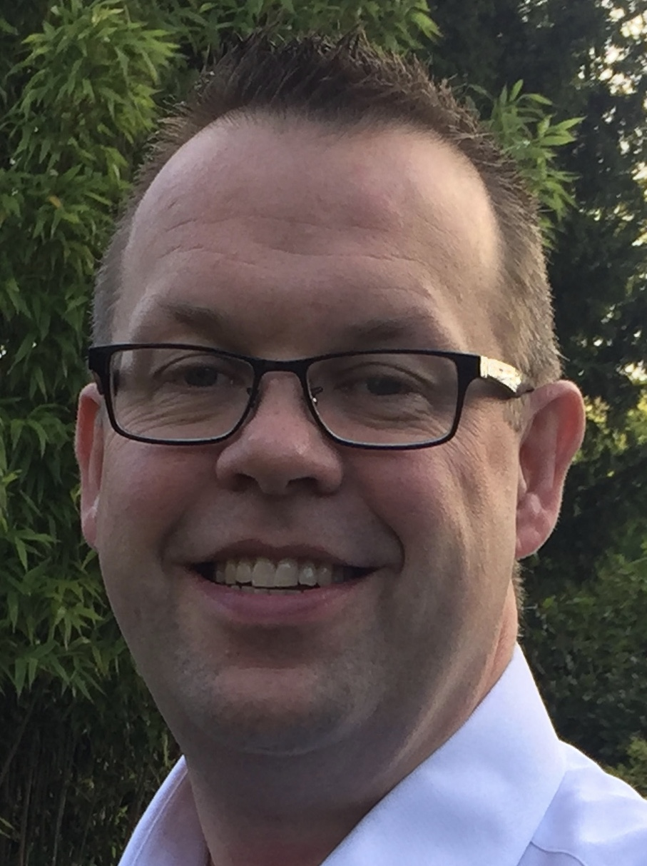
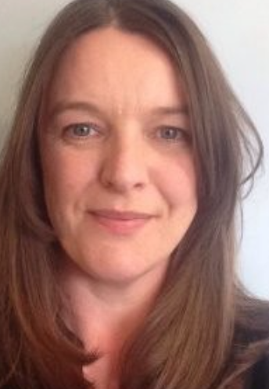



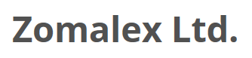


JUDGES
Martin Paver
CEO
James Smith
CTO
Lindsay Scott
Director
Mark Wilcock
Zomalex
Gareth Parkes
Company Knowledge Manager
Jon Kirby
Reporting Manager
Jonathan Norman
Major Projects Association
Notes:
YS to add jonathan norman

Slide 42
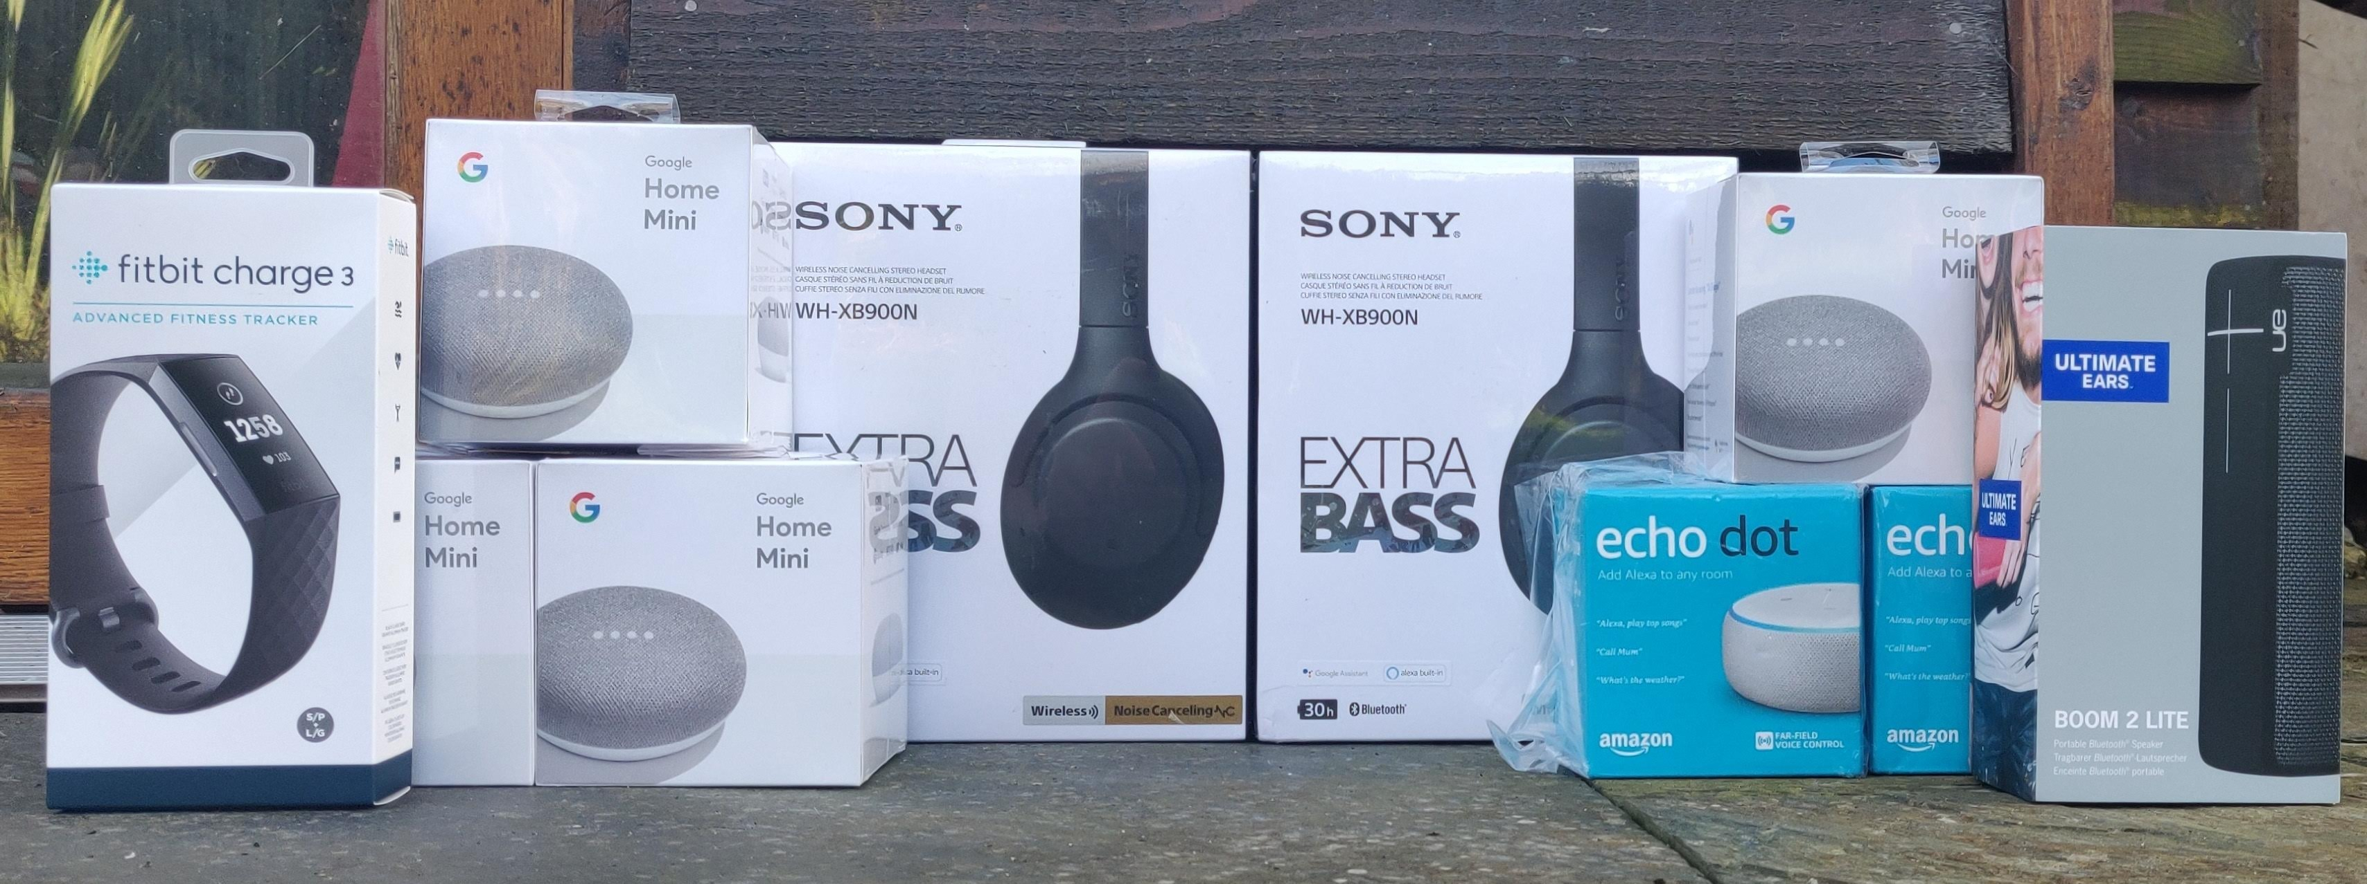


PRIZES
We have £1,000 worth of prizes up for grabs for 1st and 2nd Place teams!
Additional prizes for novice teams
Notes:
MCP/AN to add photo of prizes

Slide 43

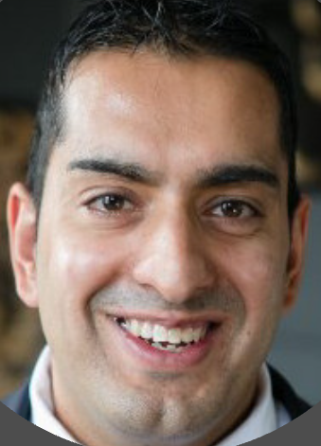
MASTERCLASS 1 @10:45
Power BI: The journey from messy data sets to clean visualisations
Using Microsoft Power BI to take attendees on a bottom-up journey from messy data sets to clean visualisations. This will include cleaning and identifying useful data, building use cases, and conducting aspirational data visualisations using schedule data from the A14 team.
Rishi Sapra
Senior Consultant

Slide 44
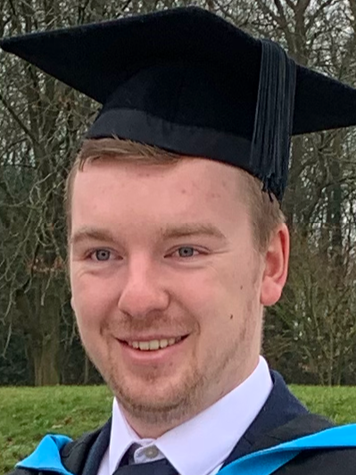
MASTERCLASS 2 @11:30
Automation for Beginners
An introduction to Robotic Process Automation with UiPath Studio X. Ben will lead an interactive demonstration on how to build a simple process with Studio X, as well as an insight into what is possible with more complex processes.
Ben Morris
Data Scientist

Slide 45
MASTERCLASS 3 @13:00
Programming for Beginners
Everyone has heard of Python these days, but do you really know what it is?! If you’ve ever come across this question, then this is the masterclass for you. We’re going to start right at the very beginning but cover a lot of ground; you’ll be running real code on your own machine and even writing some of your own!
Dr James Smith
CTO

Slide 46
MASTERCLASS 4 @13:45
Visualisation for Experts: How to spot the flaws and discover the
truth from charts and data
Or instead how to avoid being fooled by a dodgy dataset, a vexatious visual or a mendacious map. When we work on projects we often see data manipulated to mask actual performance or to support biased decisions. How do we spot these flaws and discover the truth?
Mark Wilcock
Data Science Consultant & Trainer

Slide 47

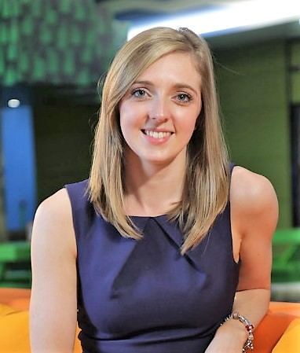
MASTERCLASS 5 @14:30
Azure for Experts: Data Science tooling in the cloud to support your hero ideas
Learn about services from the Microsoft Azure AI Platform that can support you and your hack ideas to become a reality. From where to store data, how to access compute all the way to applying AI no matter what your skillset. Amy will share hints, tips and demos for each technology as well as a link to a tutorial to get you started and you can build on for your own idea.
Amy Boyd

Slide 48

The PDU Code for this weekend’s event is:
TBC
(10 Technical, 3 Strategic)

Slide 49
Apprenticeship
With the rapidly growing demand for data driven insights, the need for data analysts/data scientists has become a necessity. We at Projecting Success have developed a new data analyst level 4 apprenticeship scheme to guide those interested in the craft, by nurturing a data skillset tailored towards project delivery. Project:Hack has been a great way to build a community of data enthusiasts so feel free to register your interest or leave any questions on the Project:Hack4 slack page at #apprenticeship, we’ll be in touch!

Slide 50
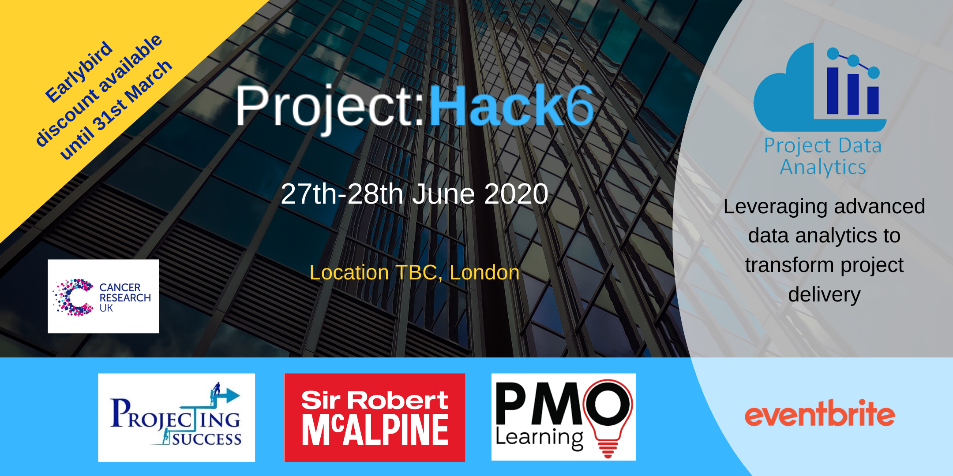
BEFORE WE START:
It's about inspiring people and developing a movement
Let's light up social media @pdacommunity #projecthack
1,300 character Linkedin post of each challenge
Tag your team and #projecthack
Write a blog for our community website (template available on the Slack channel)
Complete our feedback form – we want to know what we are doing well and how we can improve
Spread the word and help us to grow
Get people involved
Sign up to the next one! (and take advantage of our early bird discount)
Book now for Project:Hack6

Slide 51
Thank you for coming!
We would love to have you onboard as a sponsor for the next Hack – please speak to one of the team today!

Slide 52
FINAL PITCHES - RUNNING ORDER
Challenge# | Challenge Title
Challenge 1 | Optimising Crane Usage.
Challenge 2A | 'Code Your Own' PPE Object Recgonition Model
Challenge 2B | PPE Object Detection Application with Power Apps
Challenge 3 | Specification Issue Detection
Challenge 4 | Natural Language Processing on Lessons Learned Data
Challenge 5 | Voice Recognition Safety Observation App
Challenge 6 | Incident Dashboards for the Industry
Challenge 7 | Monte Carlo Risk Analysis
Challenge 8 | Sentiment Analysis of Observation Data
Challenge 9 | Early Warning Safety System

